Slide 1
It’s a bargain!
Unit 10
Ms. Aya Amir

Slide 2
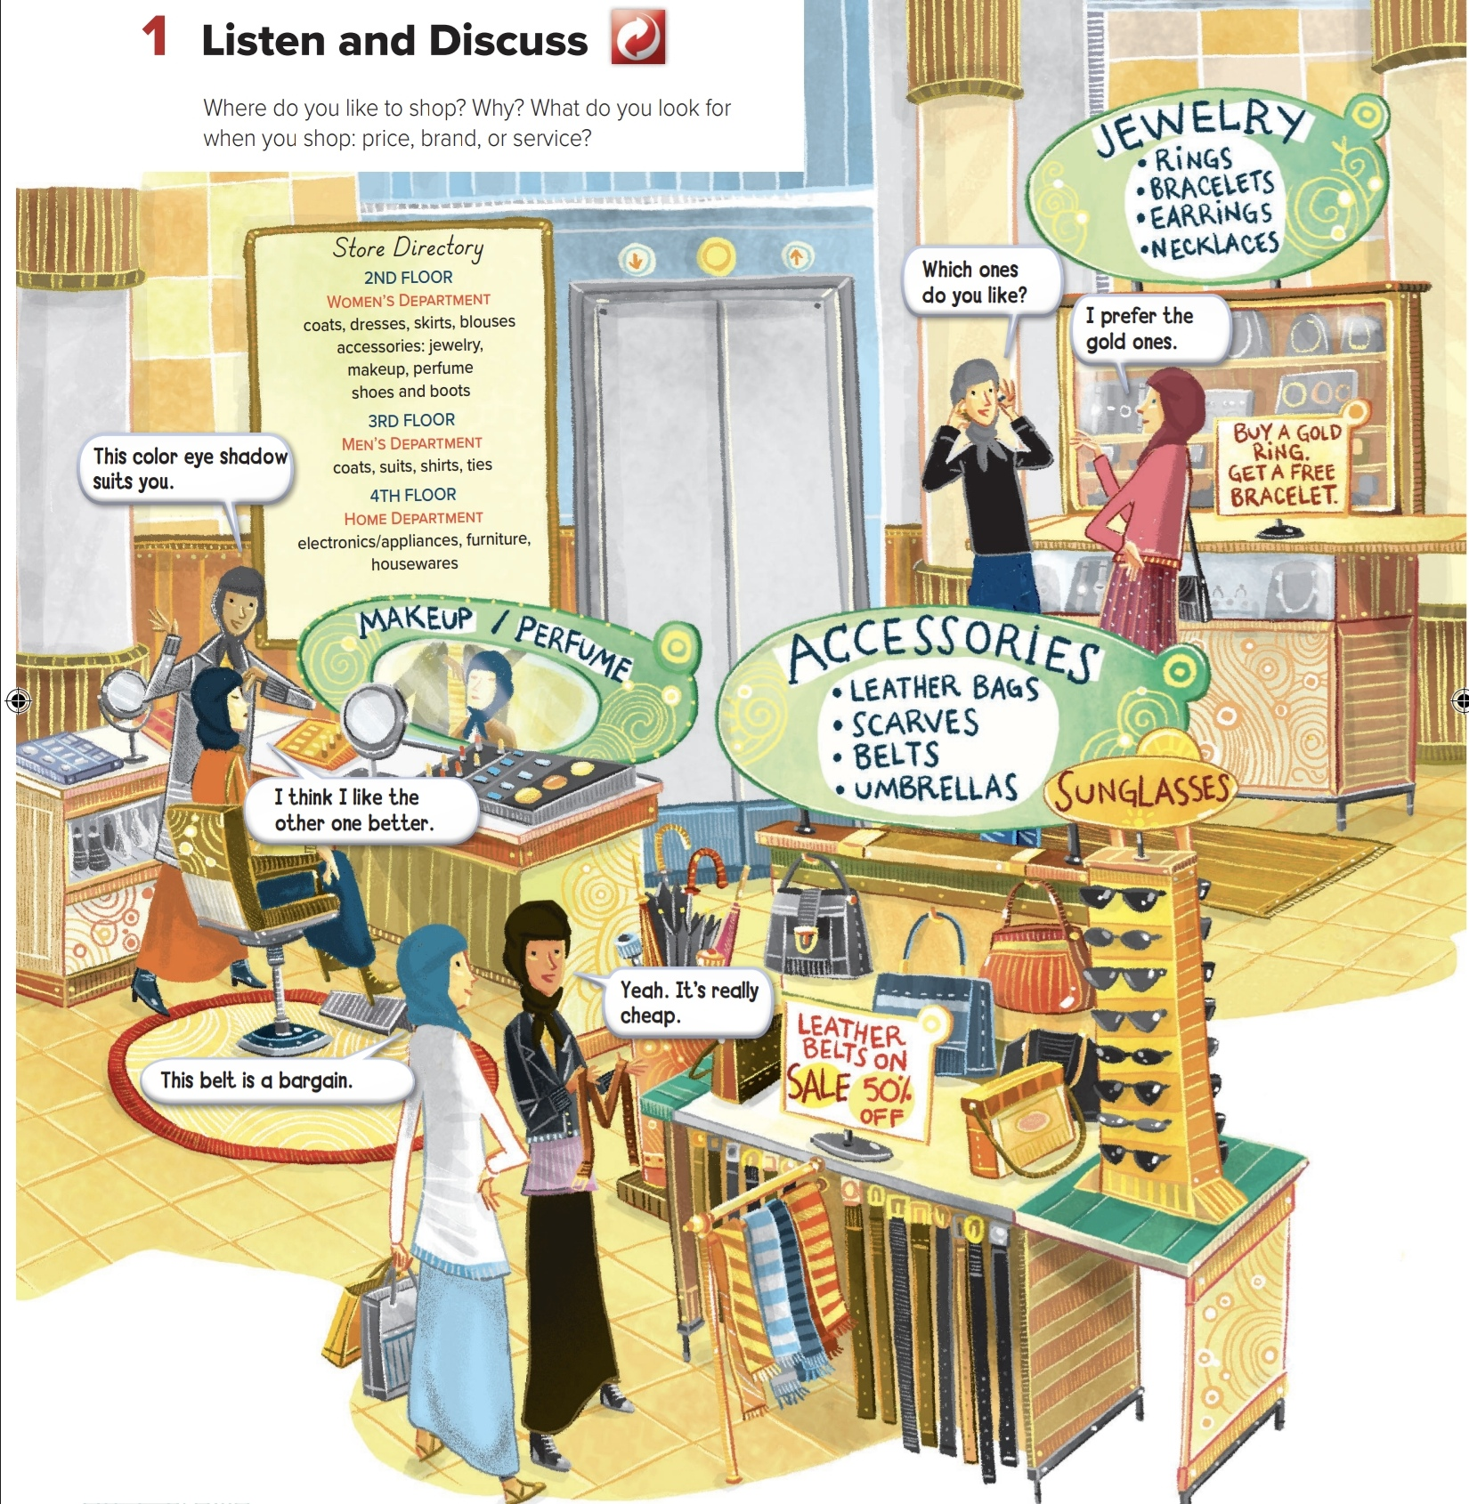


Slide 3
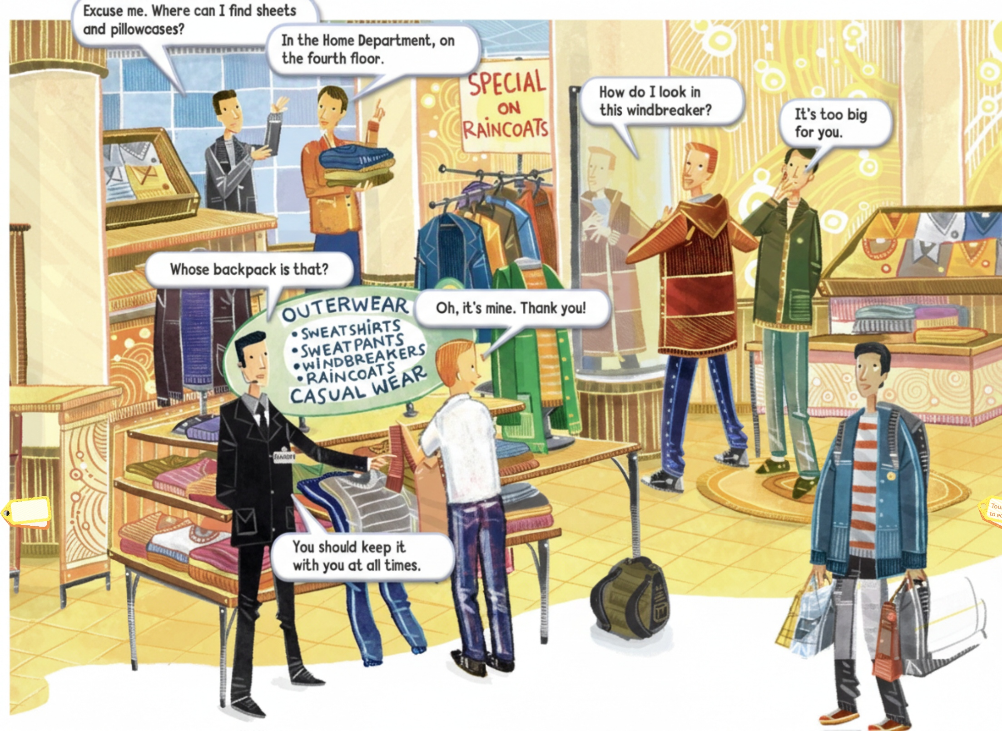

Slide 4
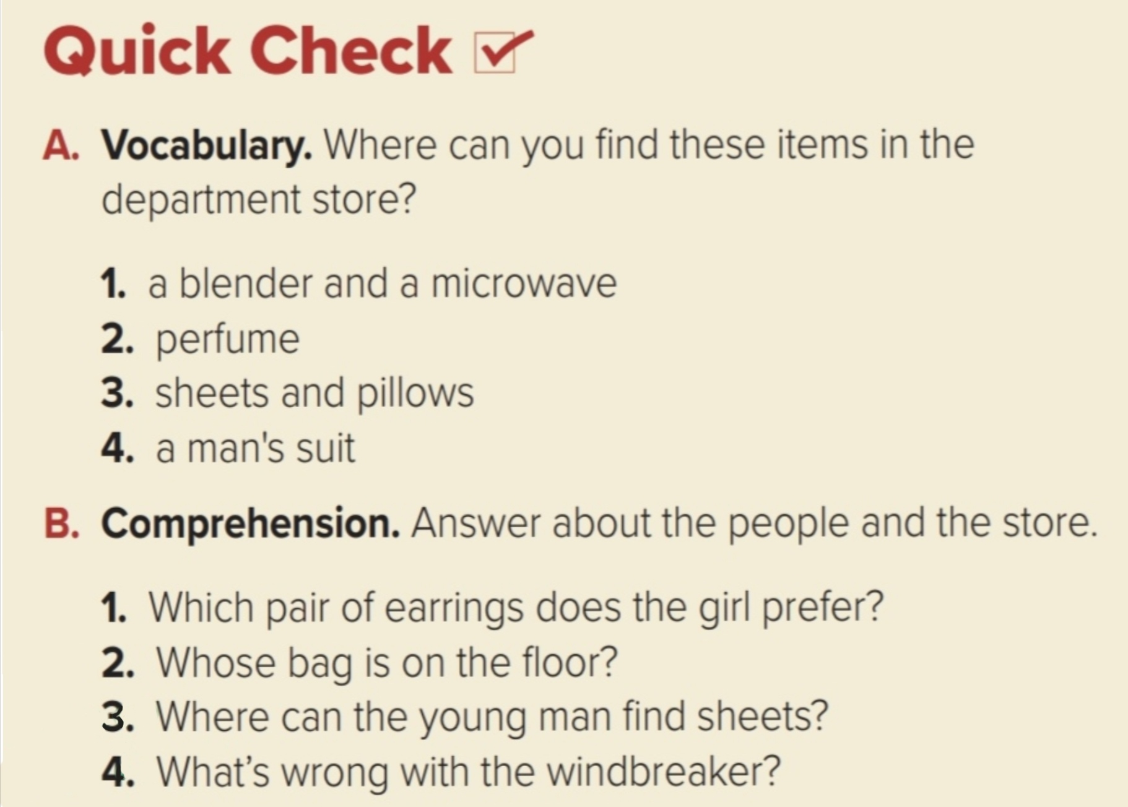
Electronics
Make up
Home department
Men’s department
the gold ones
The young man’s bag
House department
Too big

Slide 5
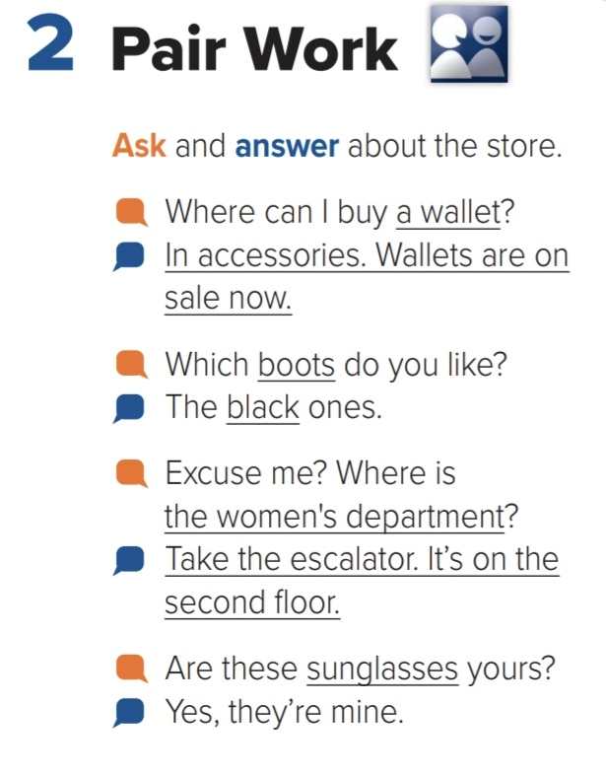

Slide 6
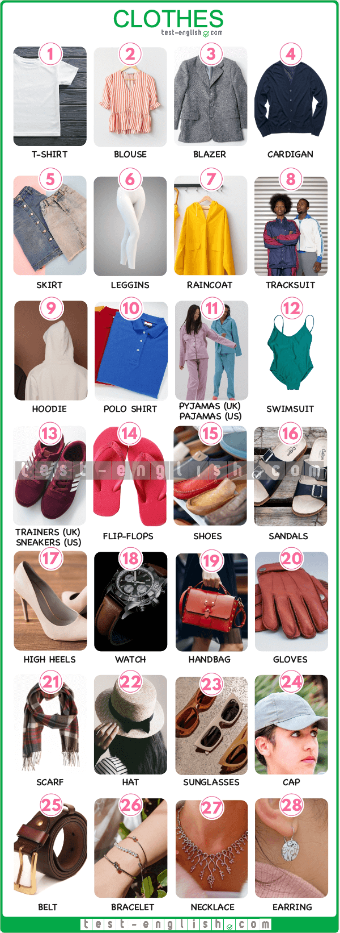

Slide 7
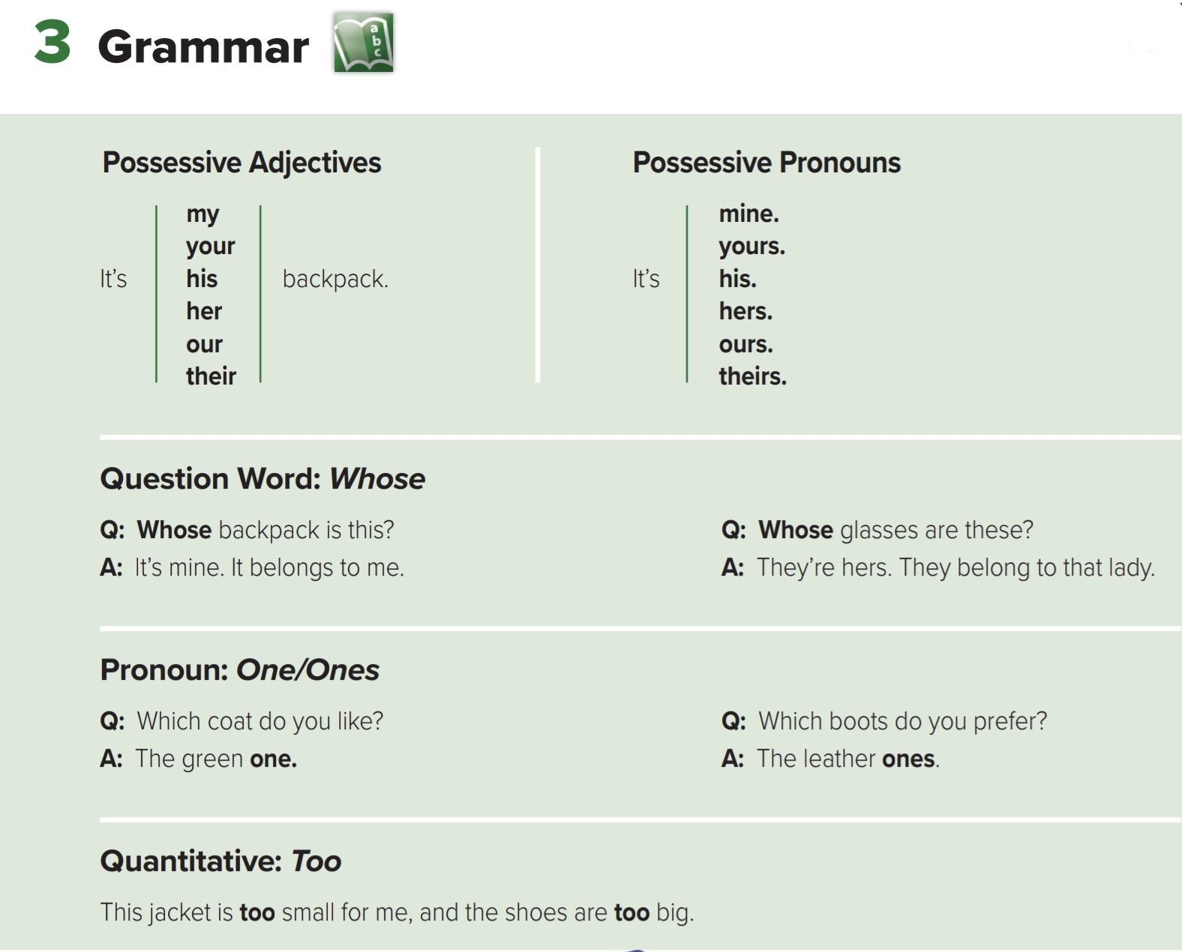

Slide 8
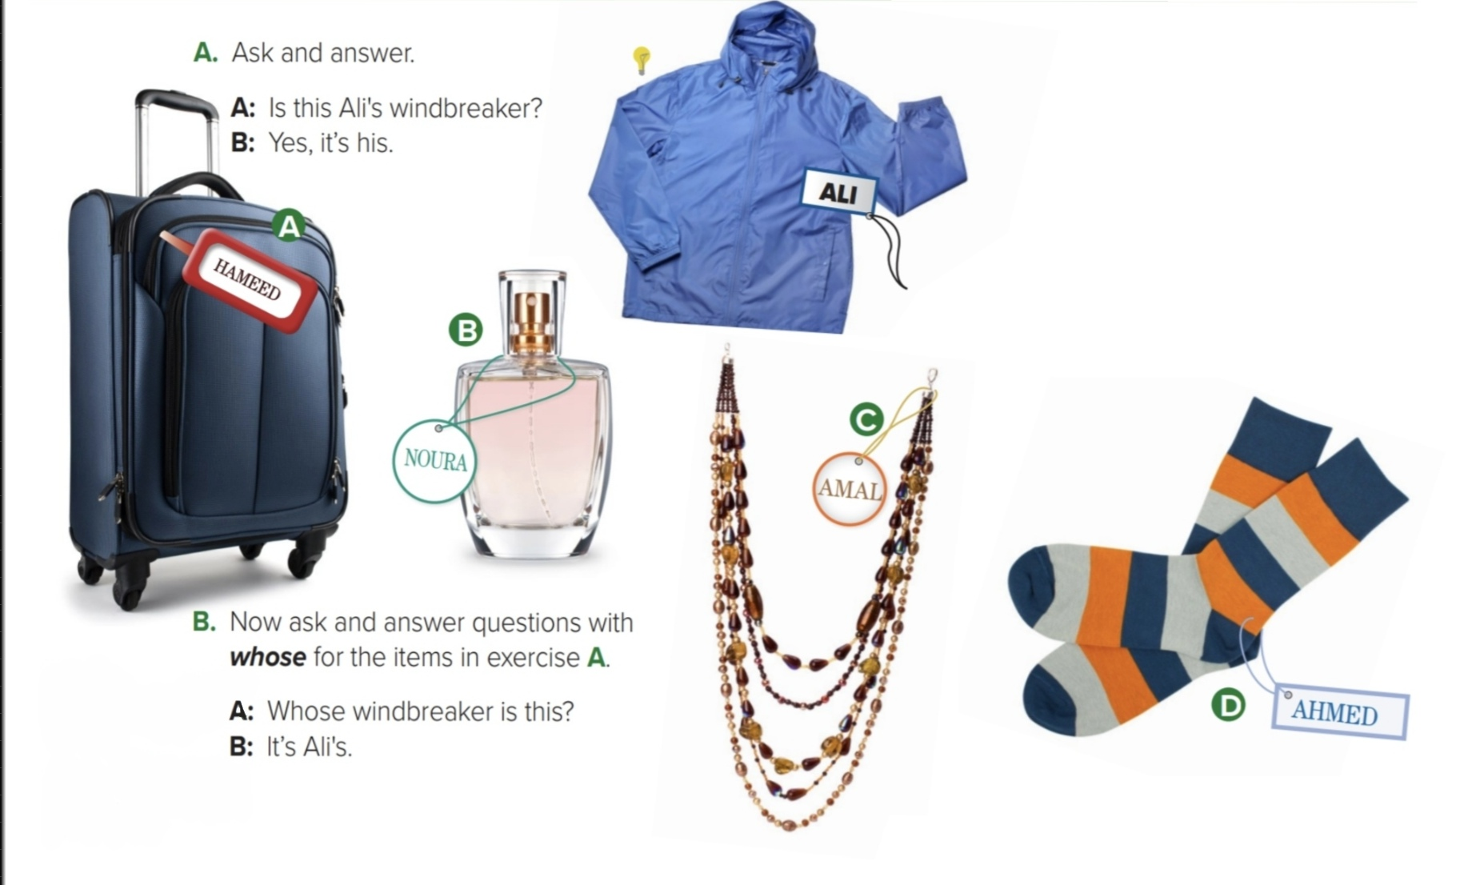

Slide 9
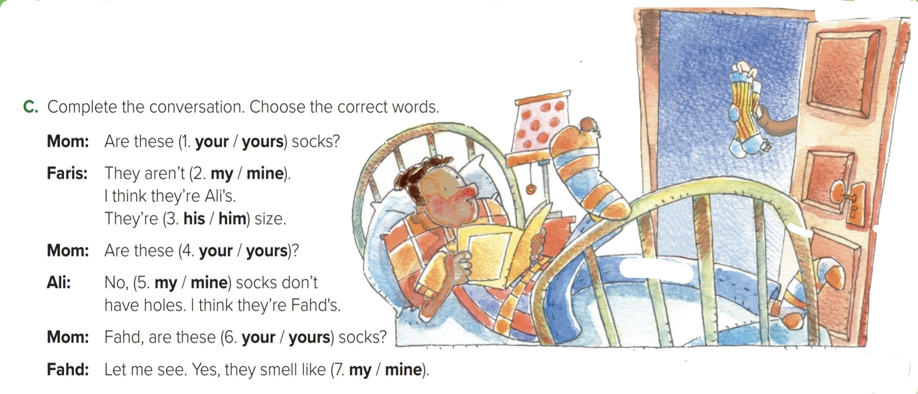

Slide 10
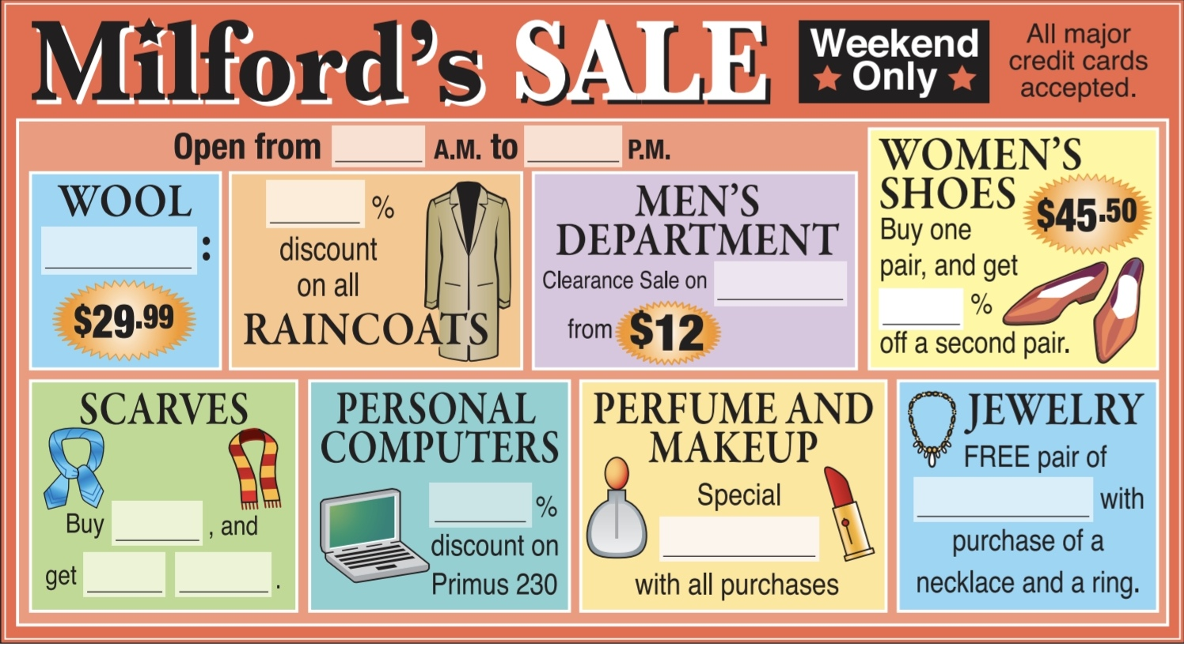
4.Listening
10
9
20
Sweaters
Shirts
50
25
Earrings
One
Gift
One free

Slide 11
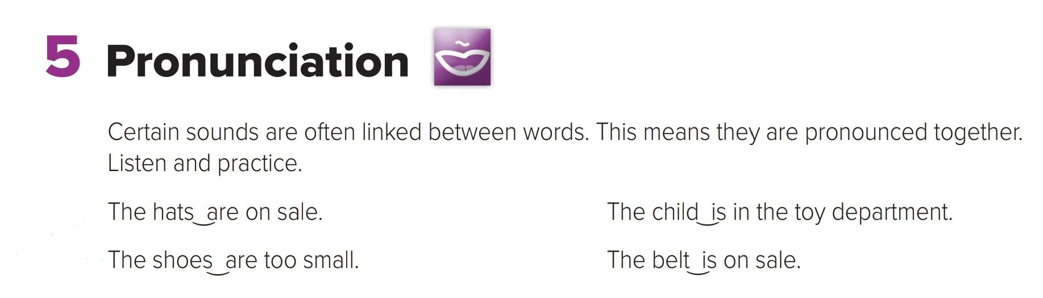

Slide 12
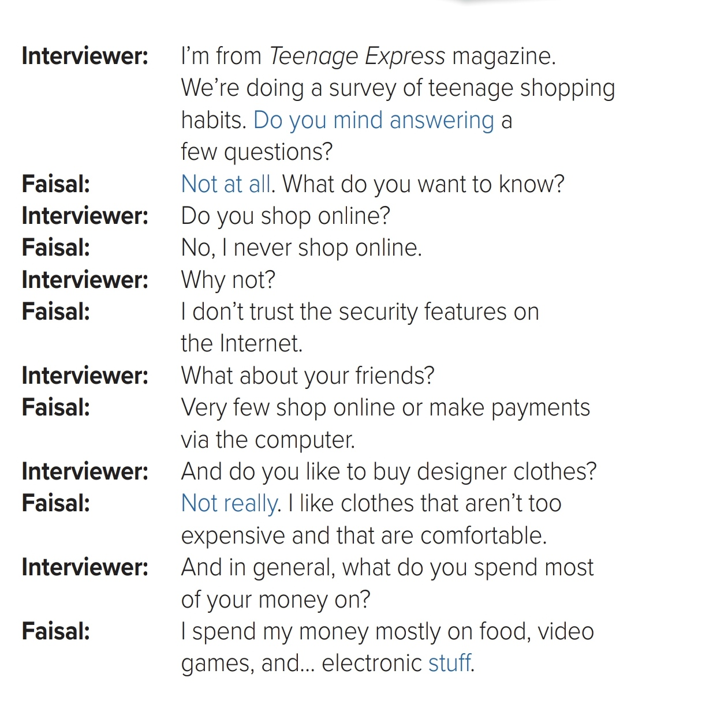
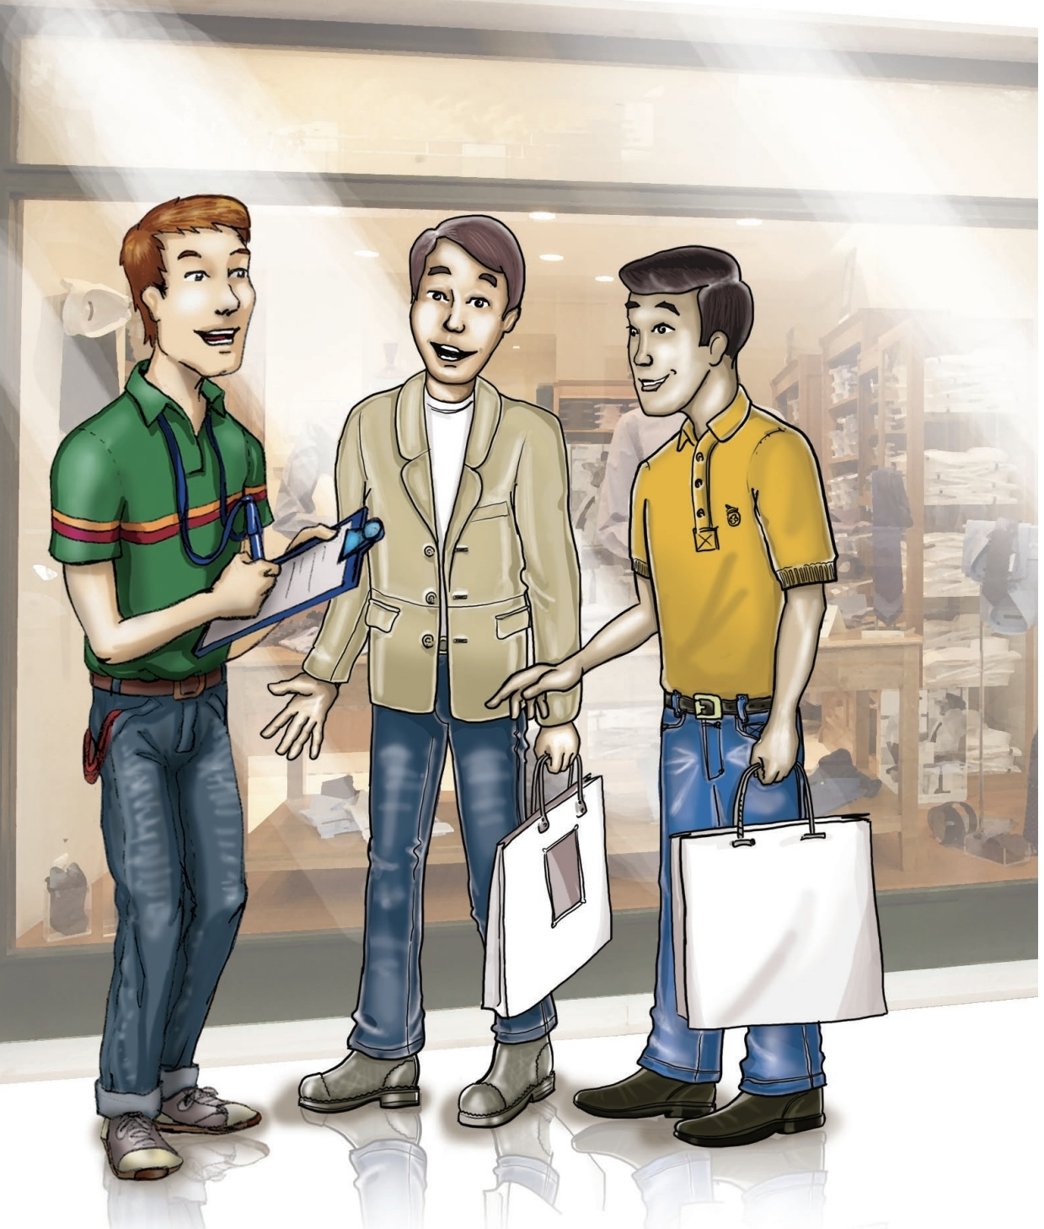


Slide 13
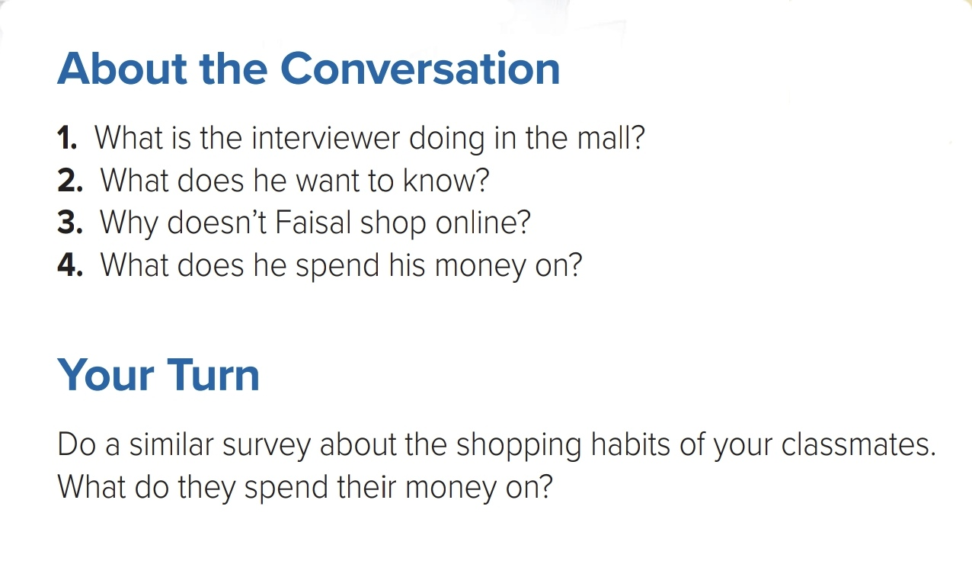

Slide 14
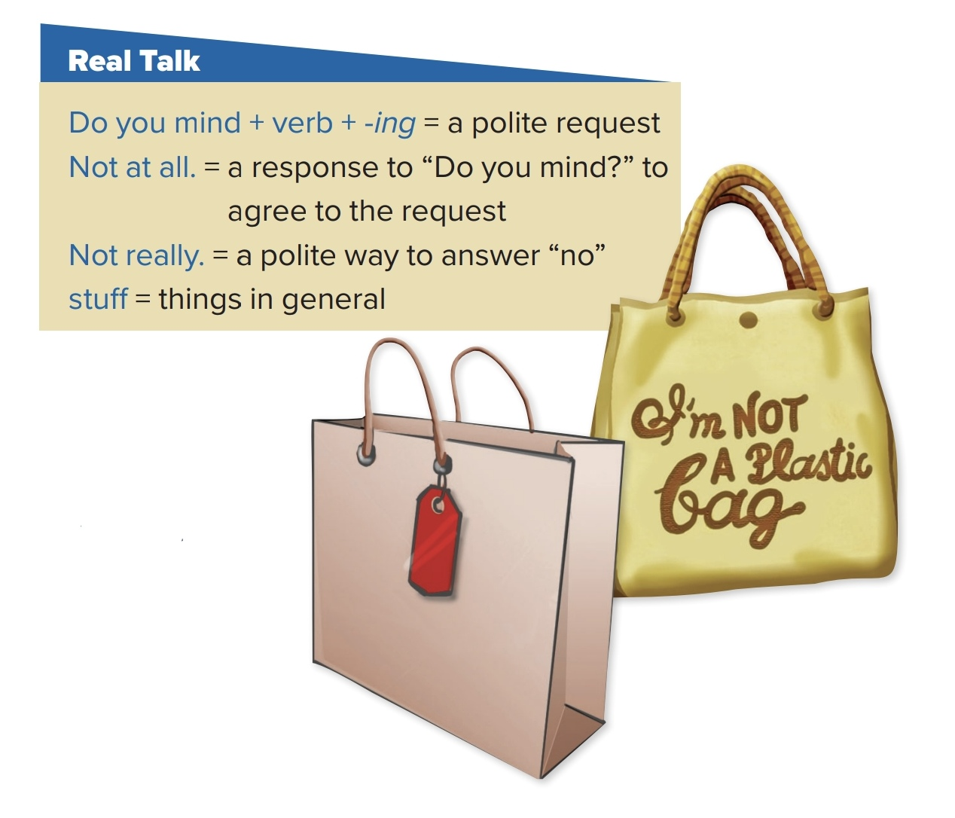

Slide 15
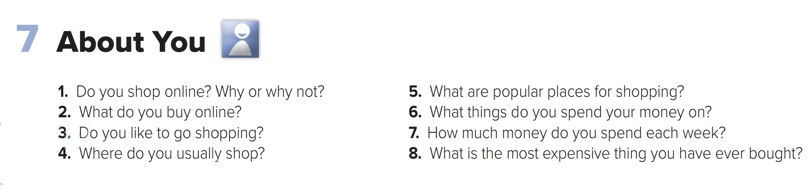
















Slide 16

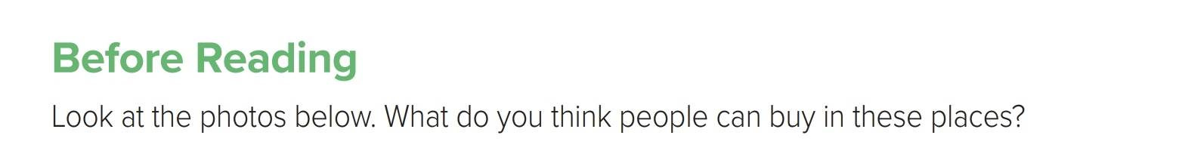
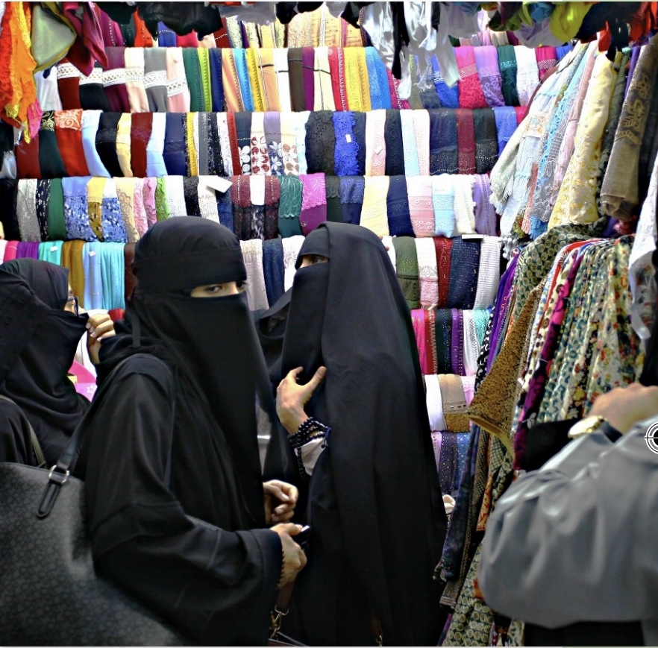
In an age where you can buy almost anything on the Internet, thousands of people all over the world still prefer to do their shopping in traditional places.
In general, shoppers look for bargains, and the best prices are usually found in street markets.
Many markets around the world have a similar lively
atmosphere and sell nearly anything you can imagine from jewelry and clothes, fresh produce, spices, and fish, to carpets, electronics, and livestock.

Slide 17
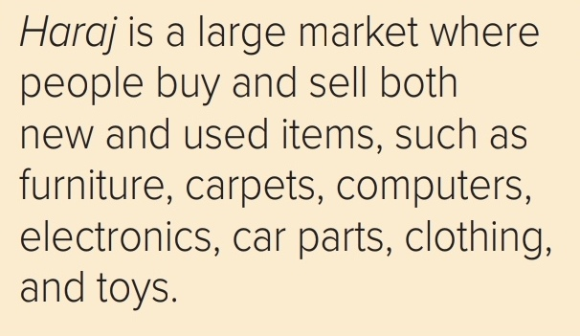
Riyadh has some of the world’s most beautiful modern shopping malls, with designer boutiques and brand names.
But if you’re looking for realI bargains, you’ll head for some of the traditional souqs in town. Haraj* is a secondhand market just east of the city.
Impress your friends and dress in Chanel and Armani for a fraction of the price, or get that new kitchen appliance you’ve been dreaming of Many of the so-called “used” items aren’t used at all—just don’t tell anyone where you bought it.
Al-Bat’ha District is home to many traditional markets. Whether you are looking for electronics and watches, jewelry, perfume, furniture, car accessories, bicycles, or food—they sell it all at often ridiculous prices.

Slide 18
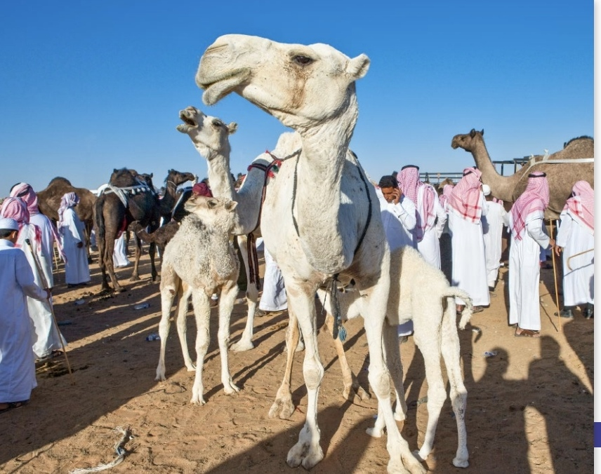
For more traditional goods, antiques, and souvenirs check out Al-Thumairi near the Al-Masmak Fort.
This is particularly popular with tourists. And nearby is the Al-Deira market where everything is worth its weight in gold, literally.
Looking for a camel? They come in all shapes, colors, and sizes at Souq Al-Jimal.
Visitors go to the local souqs for more than just shopping.
You can see and meet an amazing mixture of people from around the world.
Many feel that the cultural experience is the main attraction of these markets.

Slide 19
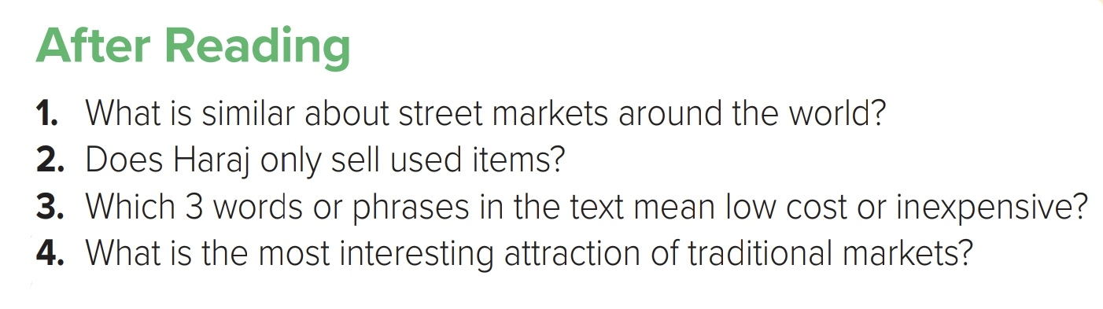

Slide 20
9. Writing
Personally, I can’t stand shopping in department stores or malls. They’re too crowded, and it takes too long to find what you want.
You buy something and then a week later, you see it on sale. I prefer to do my shopping online. It’s convenient, quick, and easy.
When you know what you want, it takes just a few minutes to compare prices. A lot of e-stores guarantee the lowest price, and they also make exchanges or refund your money when you are not satisfied with a product.

Slide 21
Many people think e-shopping isn’t safe, but that’s not true. You need to choose well-known and secure websites. And you don’t have to use a credit card because there are other ways to pay without giving personal information.
I usually buy electronic stuff, accessories for my bike, and sports clothes. I am never disappointed with the things I buy.
Only once, I exchanged a bicycle helmet because it was too
small. But that wasn’t a problem. I think that I save money this way, because I only buy what I want.
I don’t spend money on things that I don’t need.

Slide 22
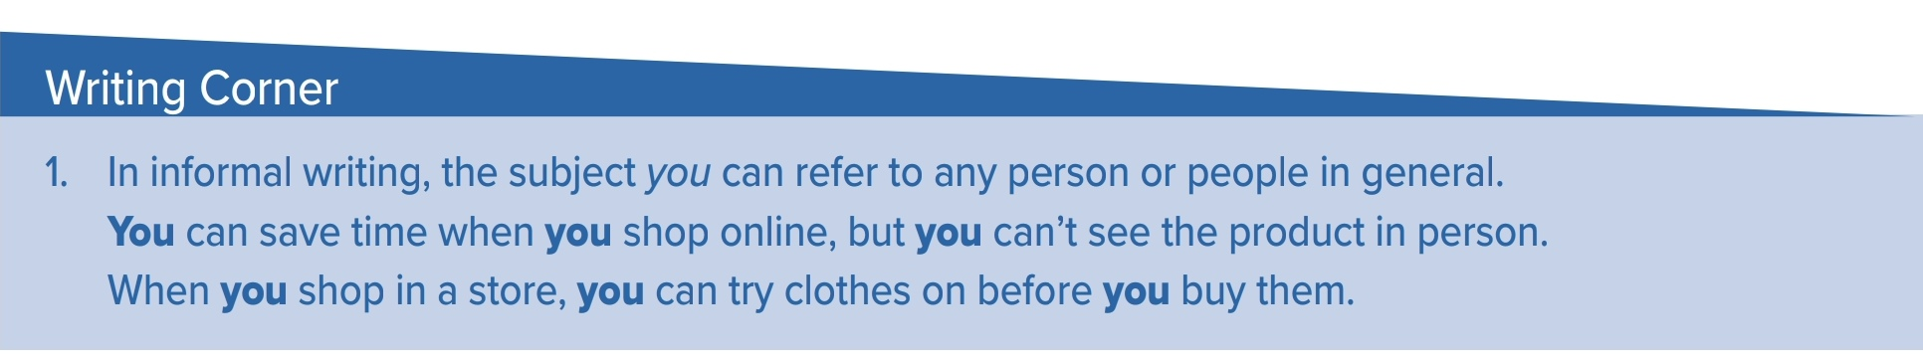

Slide 23
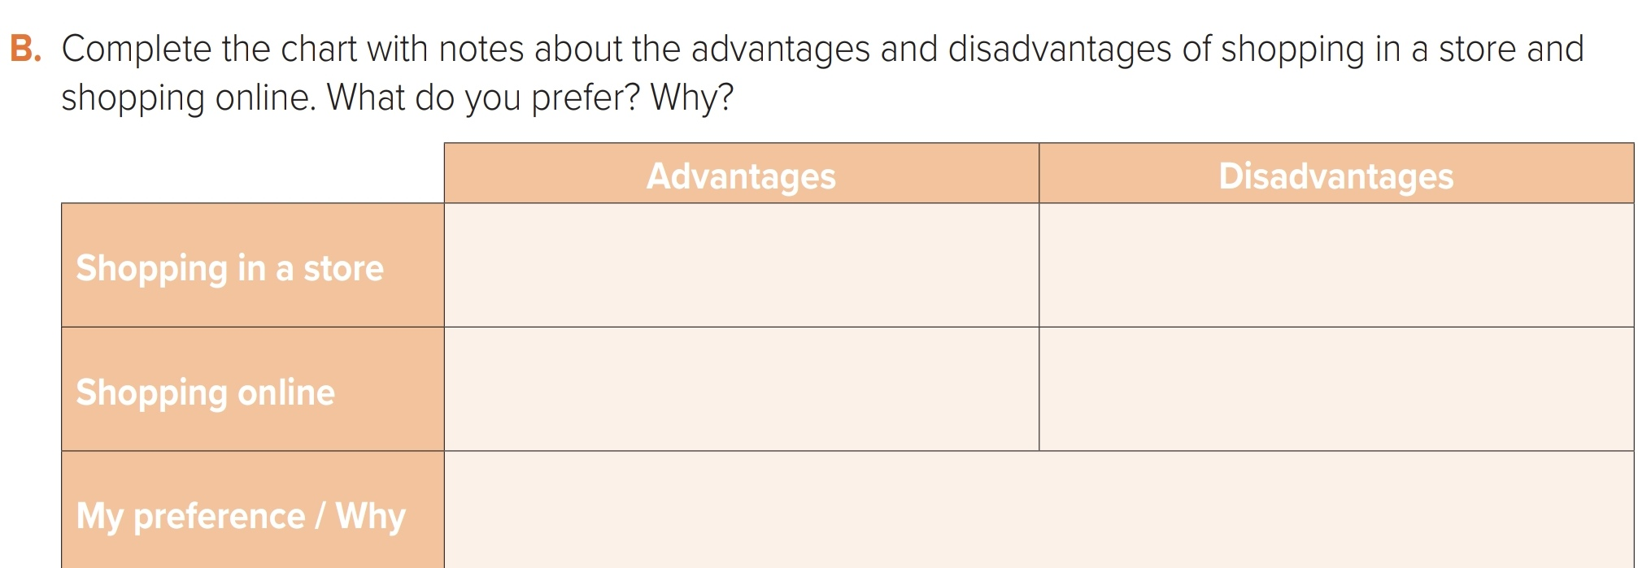
1-You can touch and see the product
2-trying the clothes before buying
3-You get the item immediately
1- Some stores are crowded especially on weekends
2- It can take a lot of time
1- Easy and fast
2- You can shop from home
3- There are many choices
1- You can’t see or touch the product
2- Delivery can take time
3- Returning items is difficult

Slide 24
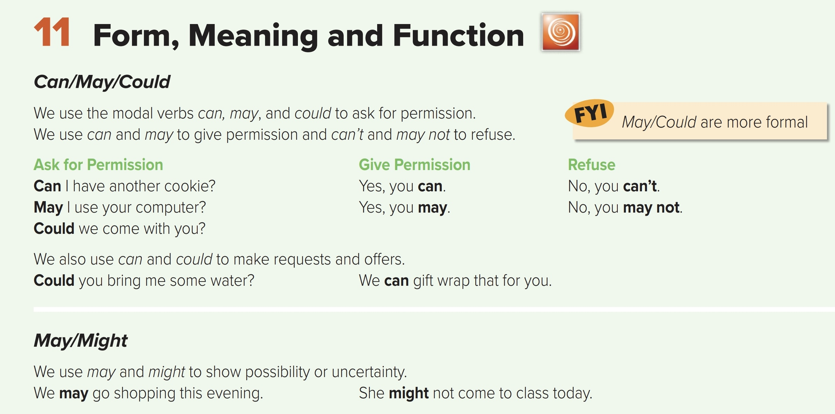

Slide 25
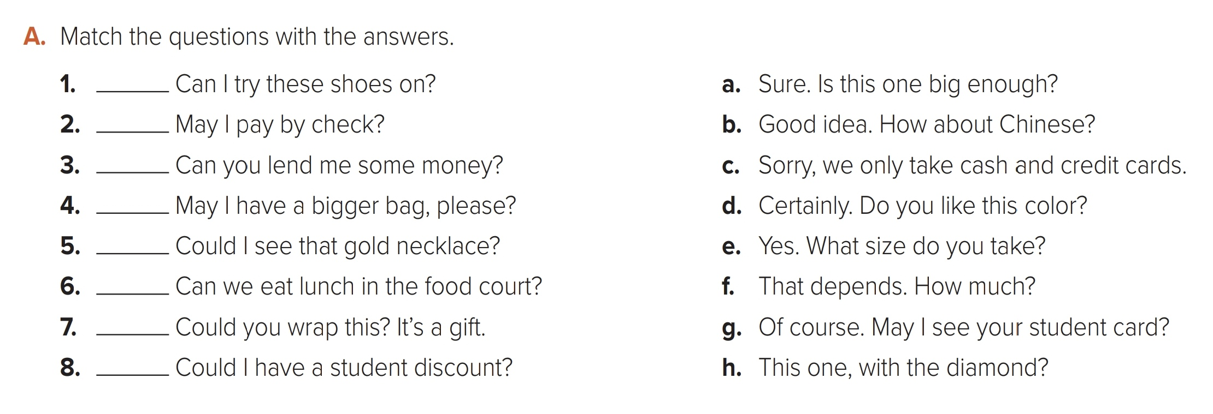
E
C
F
A
H
B
D
G

Slide 26
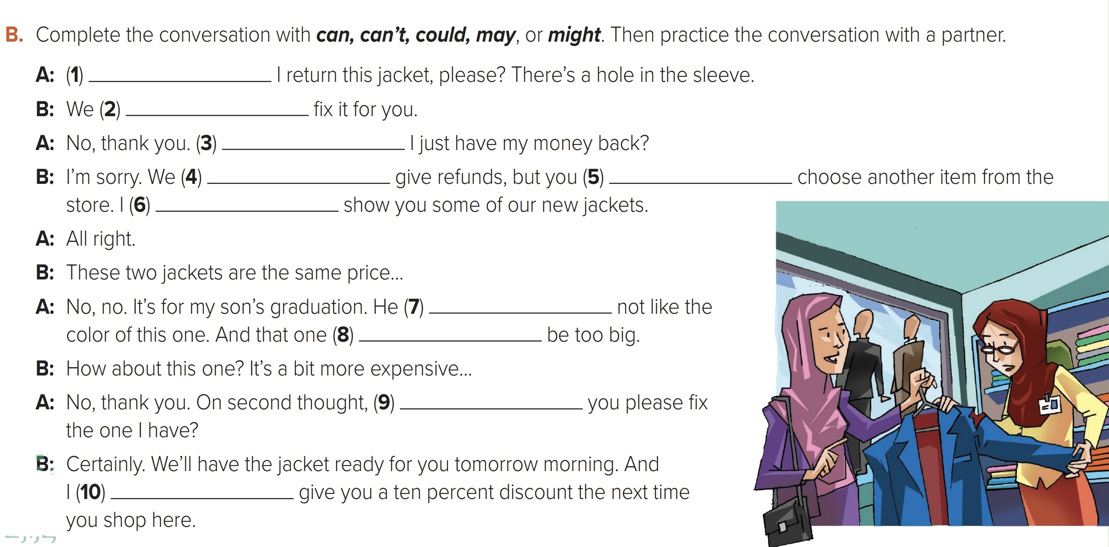

Can/Could/May
Can/could
Can/Could/May
Can’t
Can/could/may
can/could
May/might
may/might
can/could
can/could

Slide 27
SHOPPING CART THEME | 2XXX
Thank you
www.slidesgo.com

