Slide 1


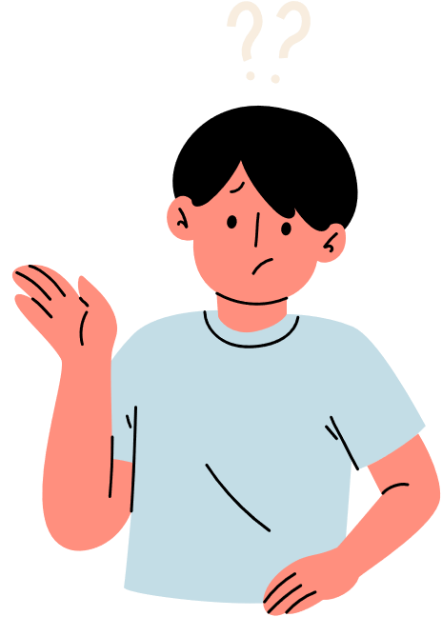


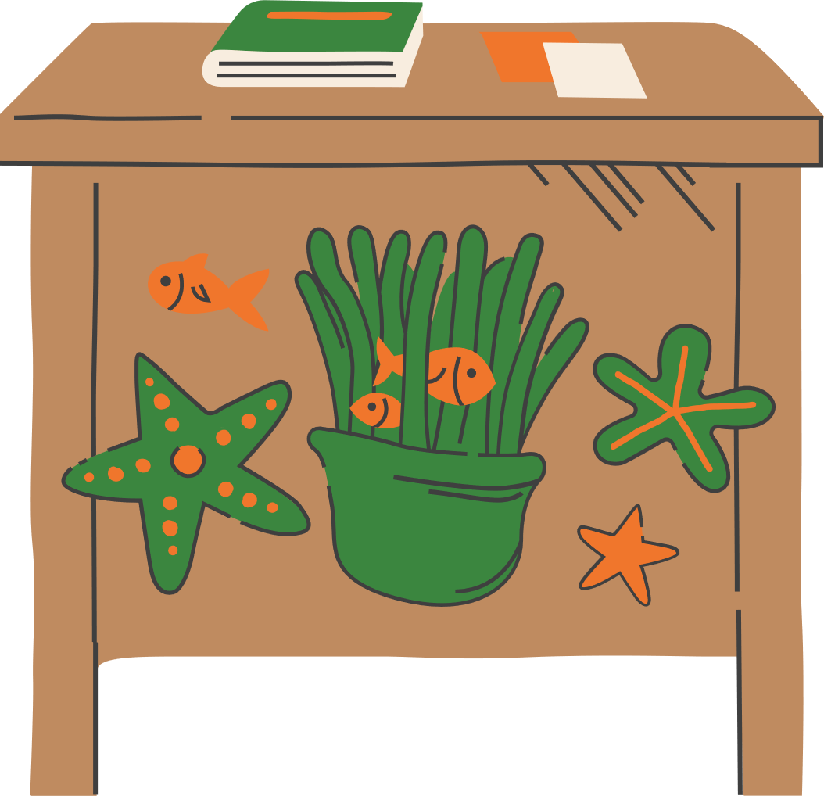
Unit 9
Unit 9
Let’s go out
Let’s go out
MS. AYA AMIR
MS. AYA AMIR

Slide 2
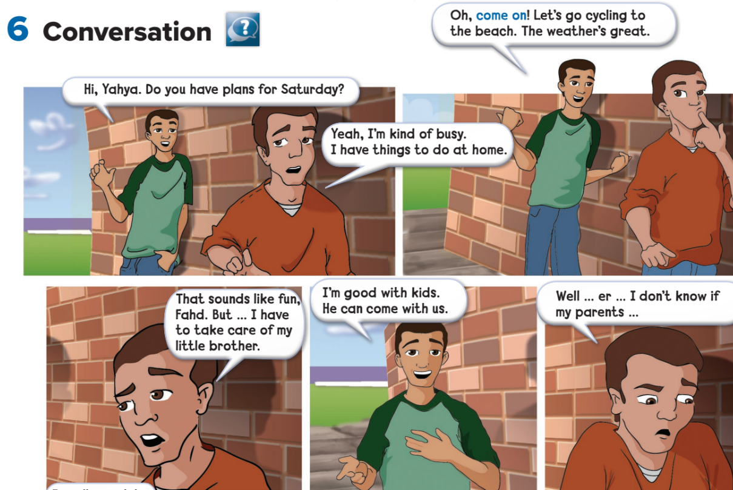


Slide 3
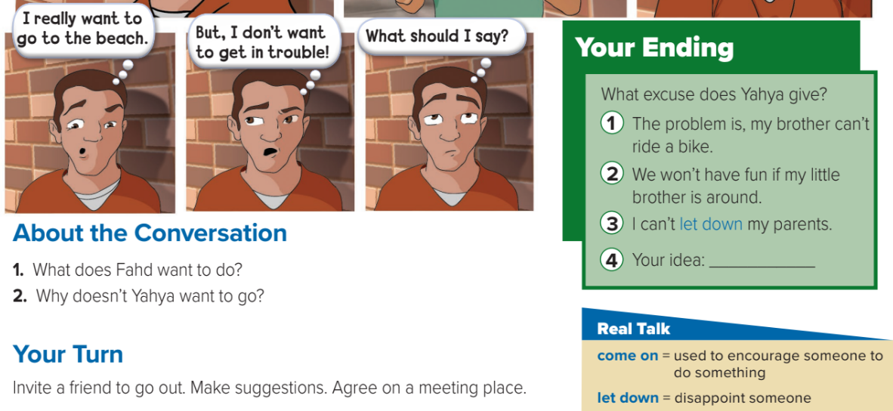

Slide 4
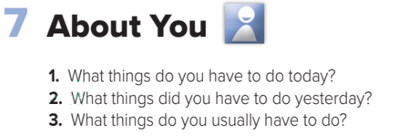
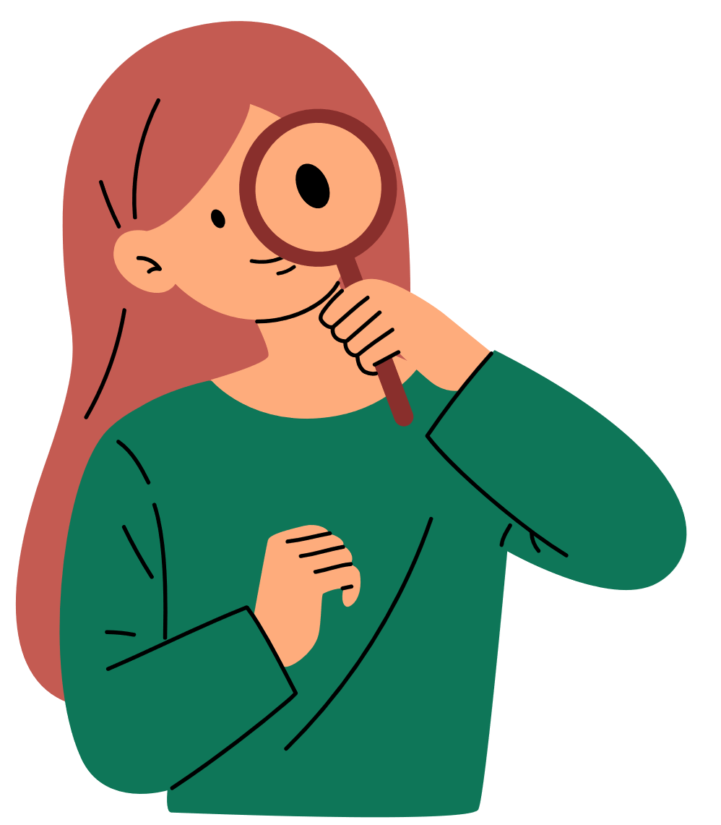

Slide 5

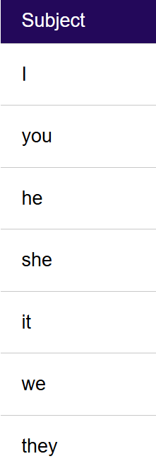
subject:
  I love teaching English.
  You are very creative.
  He plays football every weekend.
  She studies at Suez University.
  It is raining outside.
  We enjoy learning together.
  They speak both Arabic and English.

Slide 6
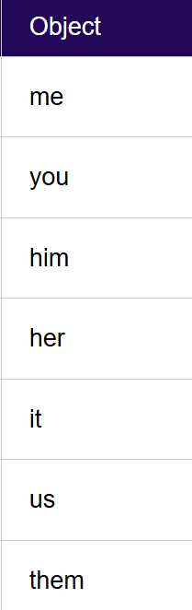
Object:
  Give the book to me.
  I will help you.
  The teacher praised him.
  We saw her at the library.
  The dog followed it.
  She invited us to the party.
  The coach congratulated them.

Slide 7
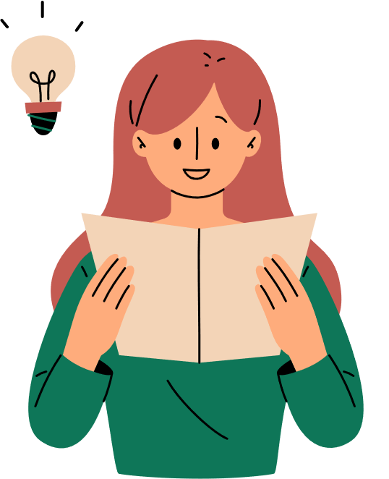
Focus!
Aya helped Omar → She helped him
Ahmed saw Aya → He saw her

Slide 8
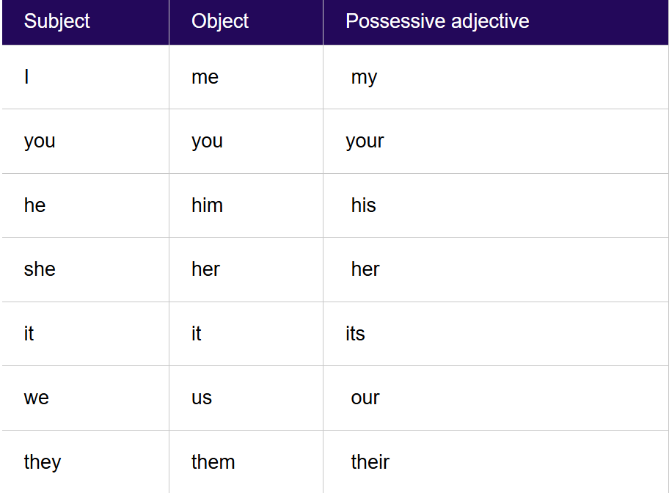
Possessive adjectives:

Slide 9
examples:
My book is on the table.
Your idea is very interesting.
His car is very fast.
Her dress is beautiful.
Its color is bright.
Our teacher is kind.
Their house is big.

Slide 10
Focus!
Aya has a laptop → Her laptop is new
Ahmed owns a car → His car is red

Slide 11
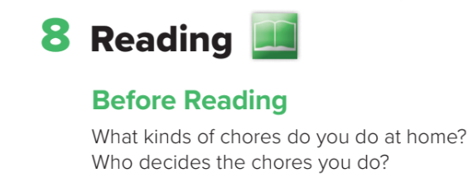
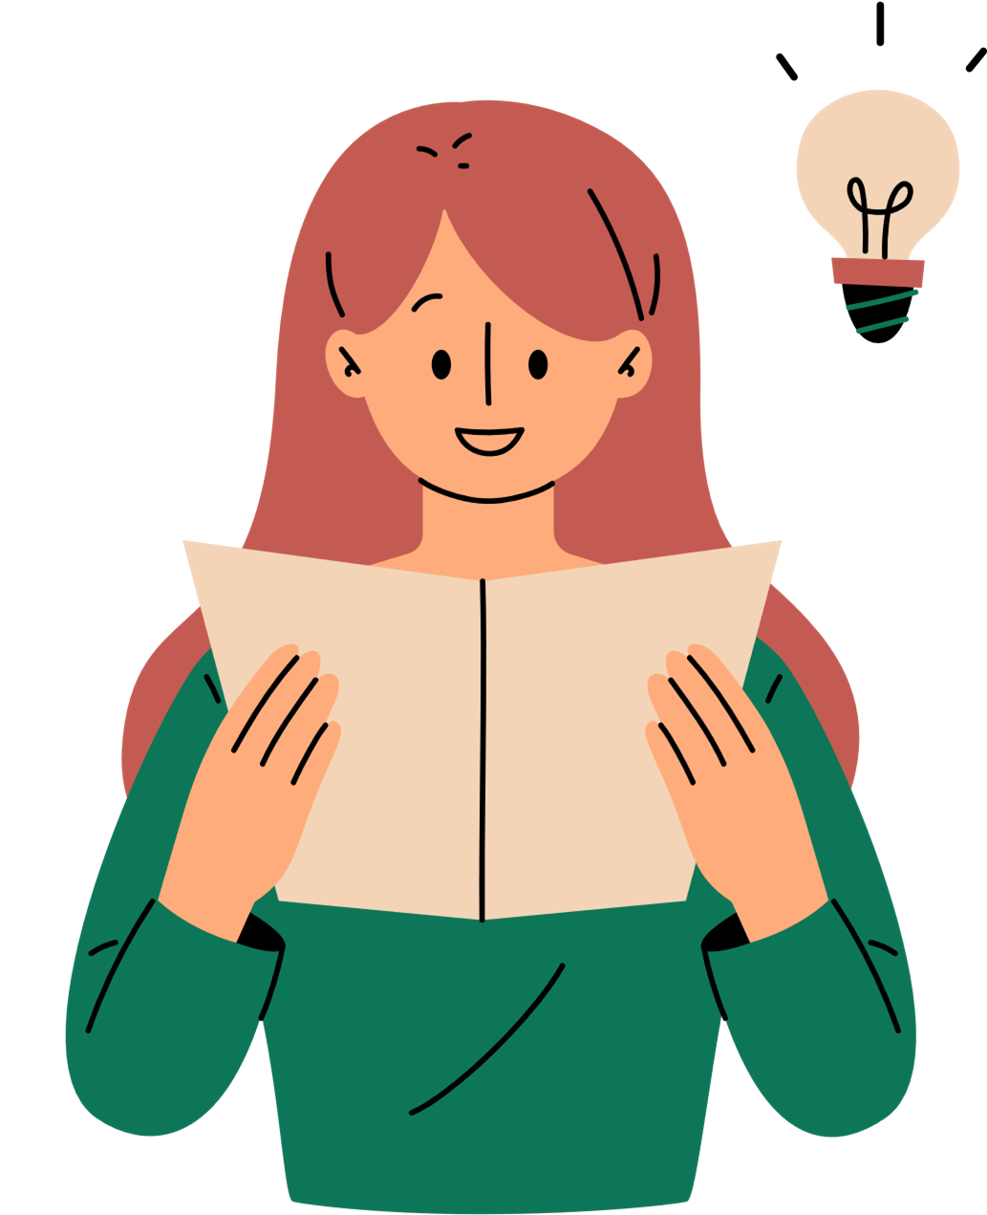
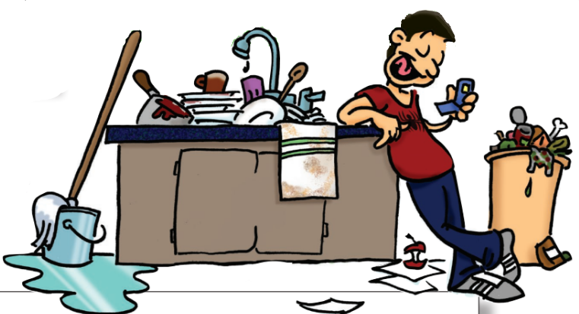

Slide 12
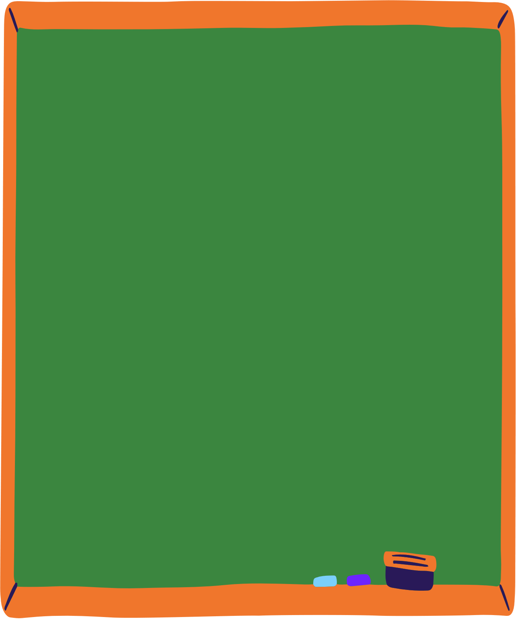
Someone has to do it!
Parents often complain that they always have to tell their teenage children to do their chores. Parents think their kids are irresponsible. On the other hand, teens feel their parents are always nagging and complaining.
A major problem is that parents think that teens need to do the chores on their schedule, while the teens think, "Why do I have to do it now, when I can do it later?“
This usually leads to unnecessary conflict between teens and their parents.
The general questions parents usually ask about chores are the following:
Should teens have them?
Should teens and parents agree on a list of chores together?
Should teens have freedom to decide when to do them?
One mother says, "My daughter and I
make a list of chores each week. That way she can organize her time for schoolwork, housework, and free time, too.“
1
2

Slide 13
Another parent only gives his son pocket money after he has done all his chores around the house. He says, "No chores, no money. It makes teens responsible for earning their money, rather than just simply giving them an allowance."
Some teenagers complain,
"My friends don't have to do chores, so why should l?"
Normally parents expect their teenage sons and daughters to help around the house.
But parents and teens have to agree on the kind of chores and when the teens have to do them.
One mom's son wants to do his chores after he goes out with his friends, but then he's usually too tired.
Another mother only lets her daughter see her friends after she finishes
all the housework. But housework never ends!
So what's the solution? Teens and parents have to reach a compromise.
There has to be common sense on both sides, don't you think?

Slide 14





  Compromise
freedom
Allowance

Slide 15
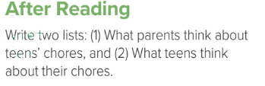
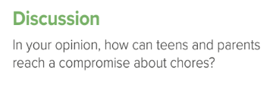
What parents think about teens’ chores:
•Chores teach teens responsibility and life skills.
•Teens should help at home because everyone in the family has duties.
What teens think about chores:
•Chores take away their free time and make them feel tired.
•Some chores feel unfair or too difficult.
In my opinion, teens and parents can reach a compromise by talking openly and listening to each other. Parents should consider teens’ schoolwork and free time, while teens should understand the importance of helping at home. They can agree on fair chores and clear rules so that everyone feels espected and responsible

Slide 16
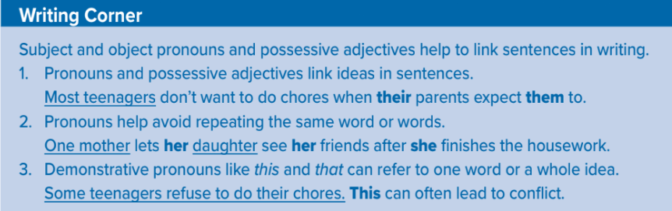

Slide 17
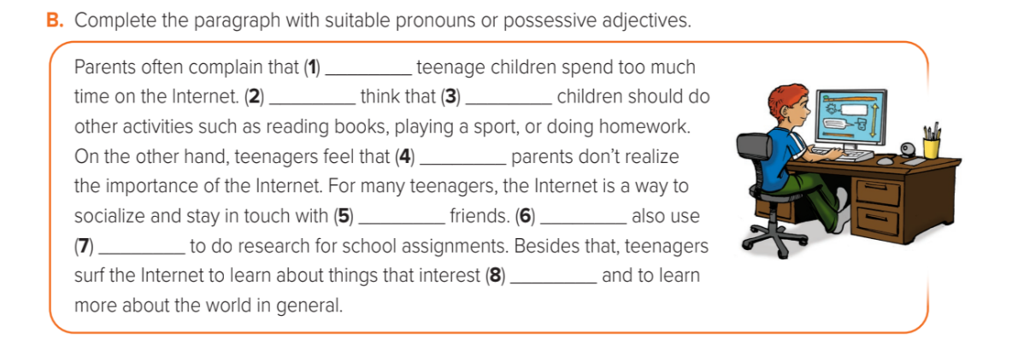
Their
They
Their
Their
They
Their
It
Them

Slide 18
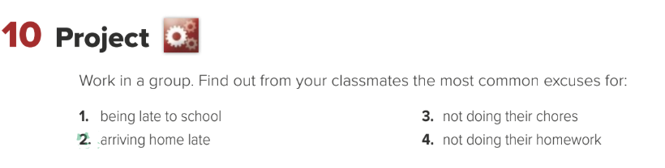

Slide 19
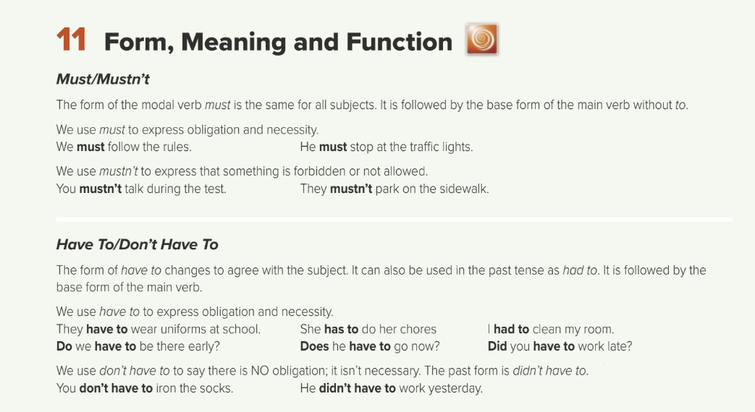


Slide 20
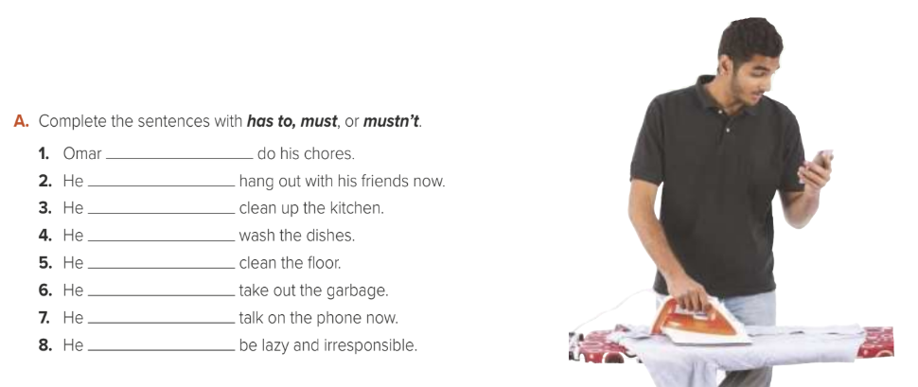
Must/Has to
Mustn’t
Must/Has to
Must/Has to
Must/Has to
Must/Has to
Mustn’t
Mustn’t

Slide 21
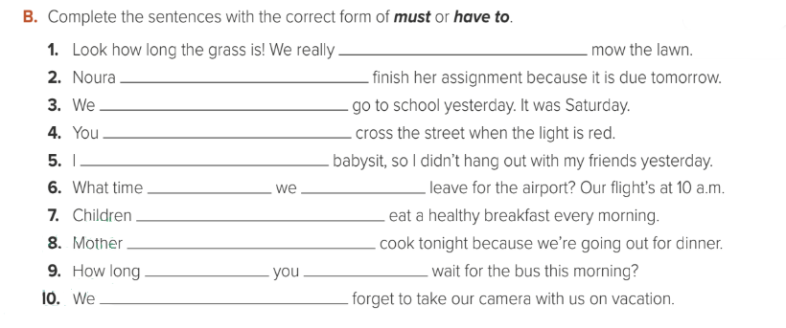

Must / have to
Must/ has to
Didn’t have to
Mustn’t
Had to
Do
Must / have to
Must / have to
Doesn’t have to
have to
Did
Mustn’t

Slide 22


You did it !
See you next time.
Thanks for watching

