Slide 1


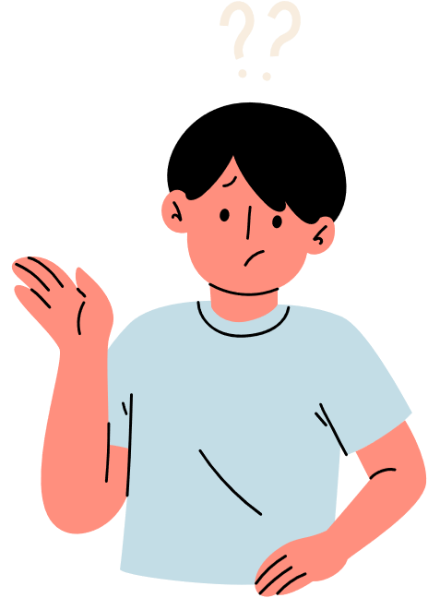


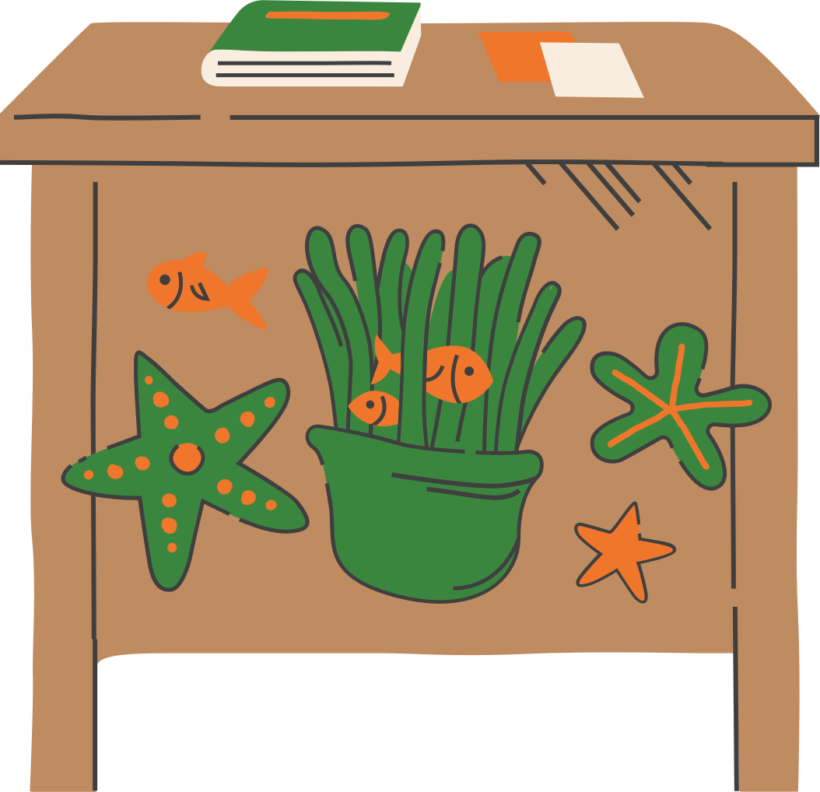
Unit 9
Unit 9
Let’s go out
Let’s go out
MS. AYA AMIR
MS. AYA AMIR

Slide 2
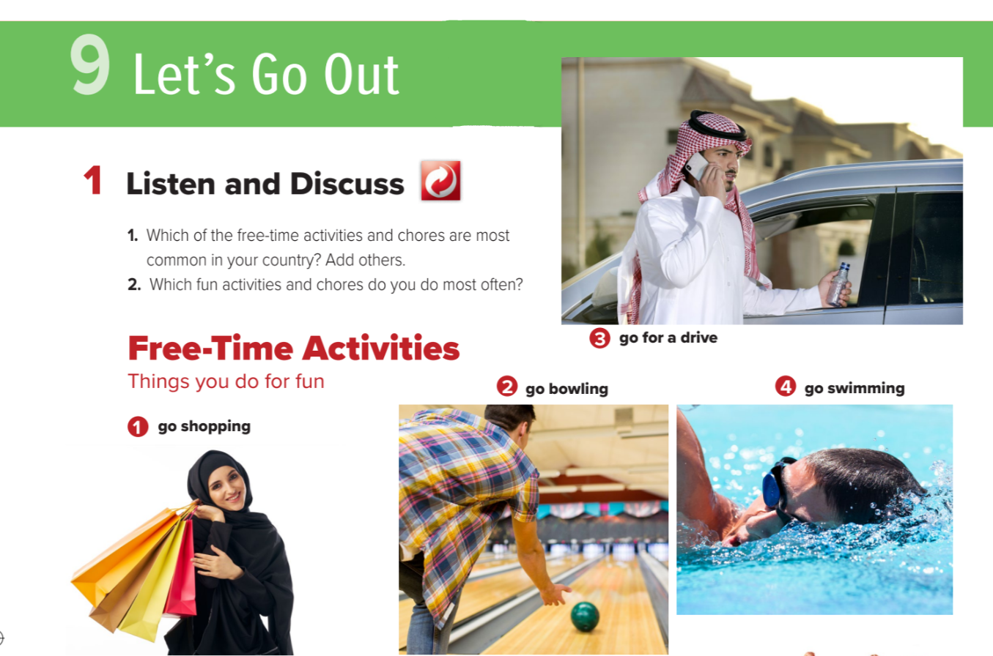


.
New Vocabulary!

Slide 3
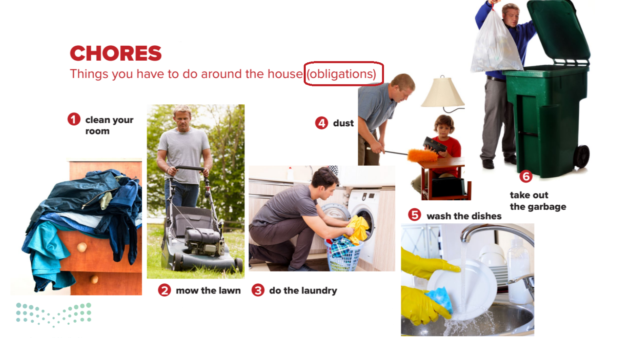
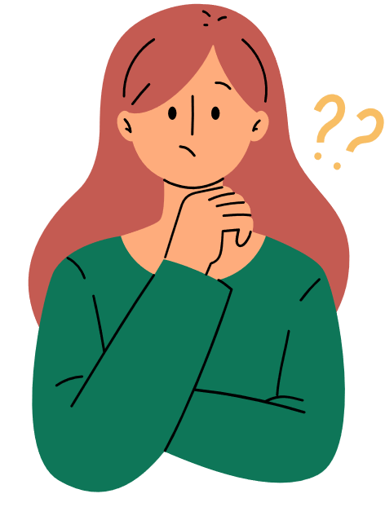

Slide 4
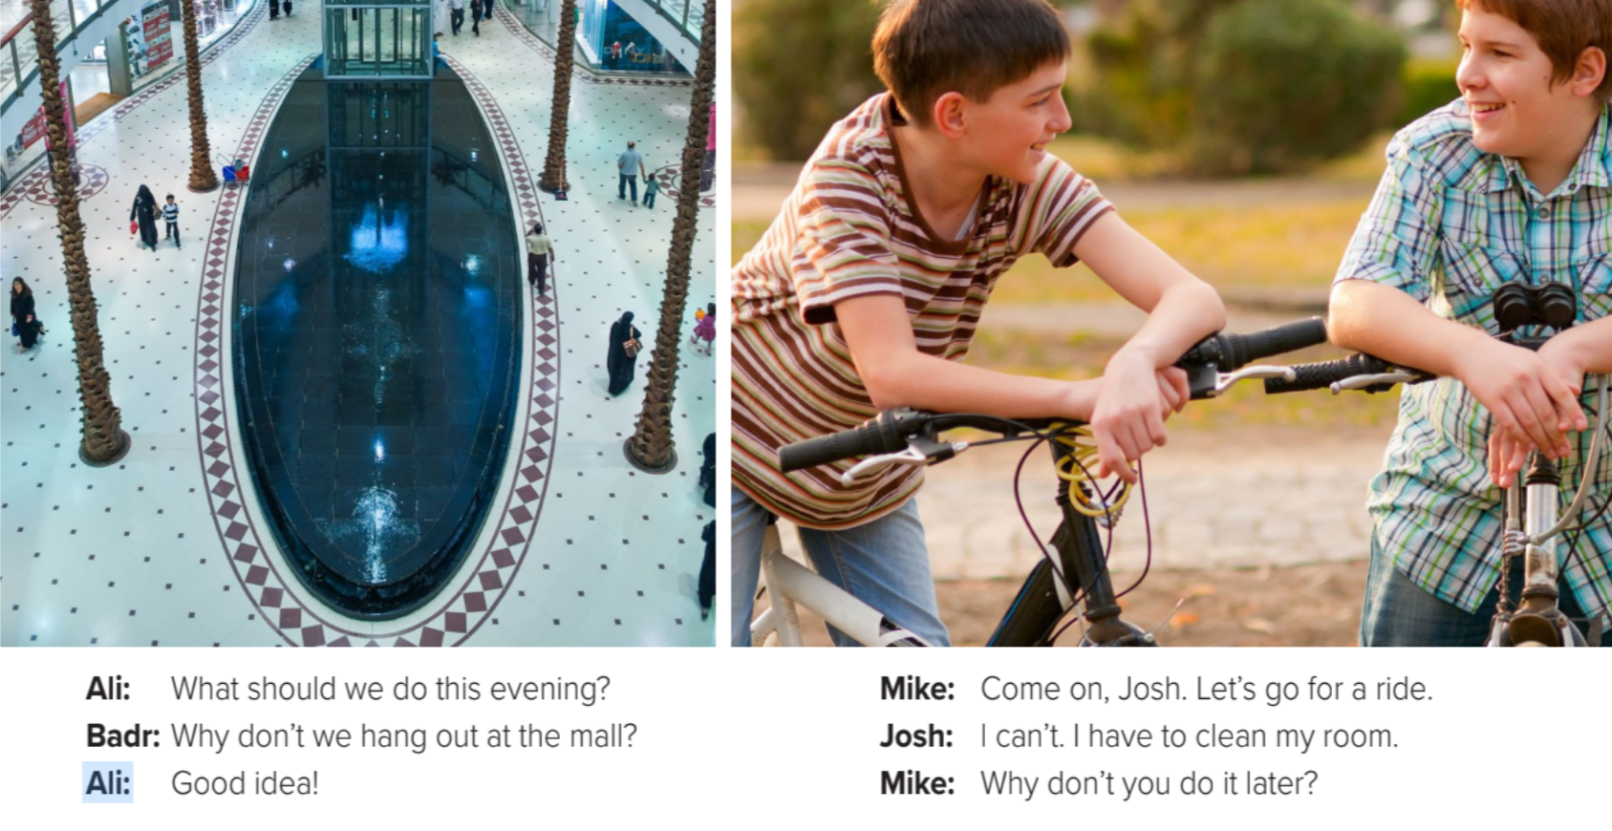

Slide 5
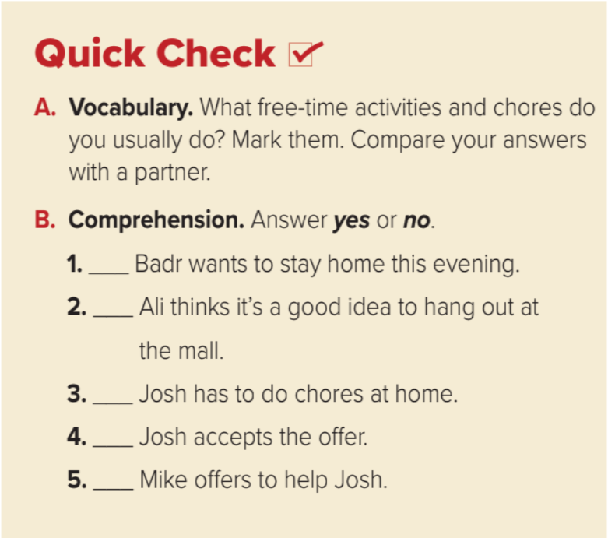

No
Yes
Yes
No
No

Slide 6

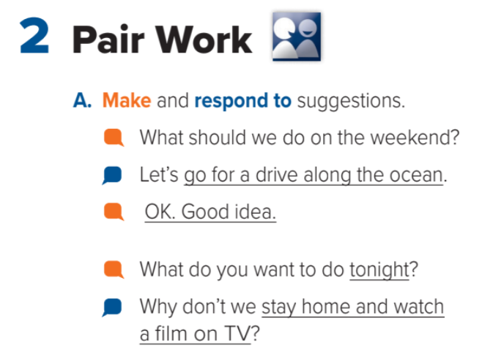
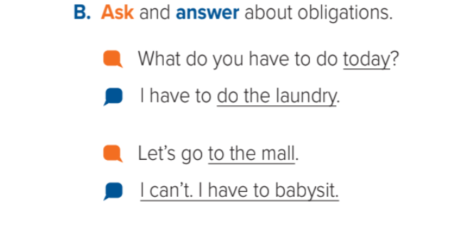
Focus on the underlined:

Slide 7
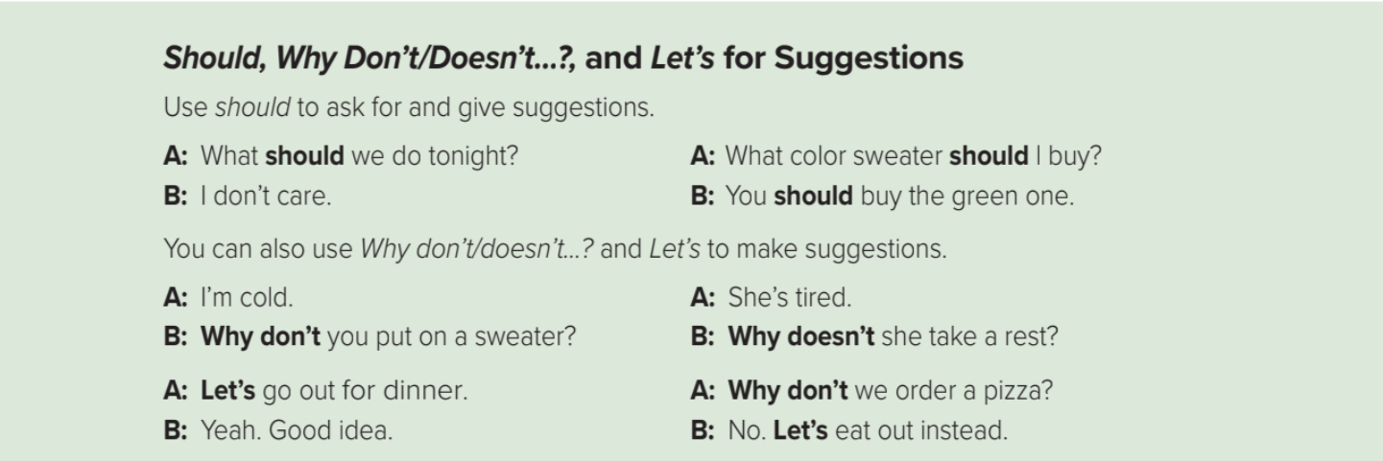
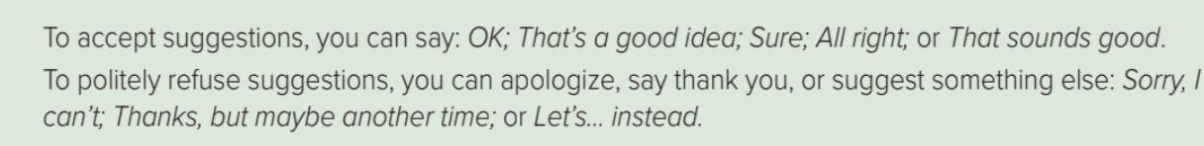
Objective Case

Slide 8
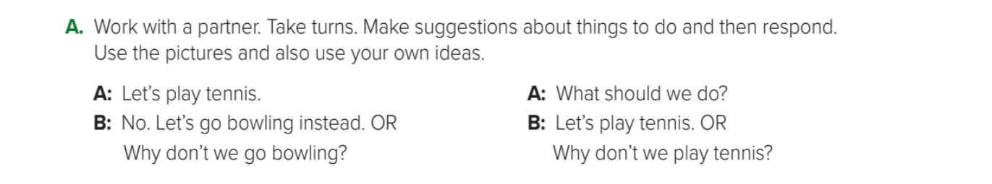
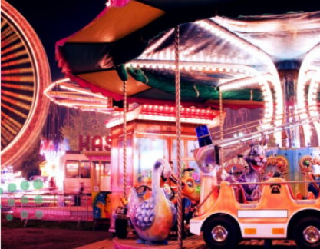

Let's Think
A: Let's go to the amusement park.
B: No. Let's go zoo instead

Slide 9
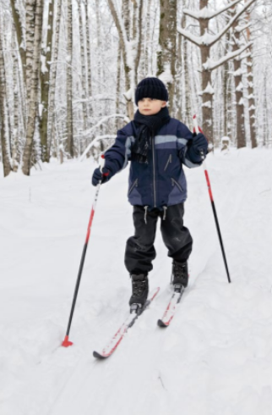
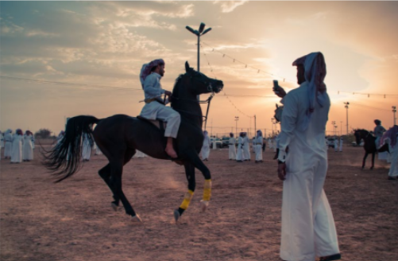
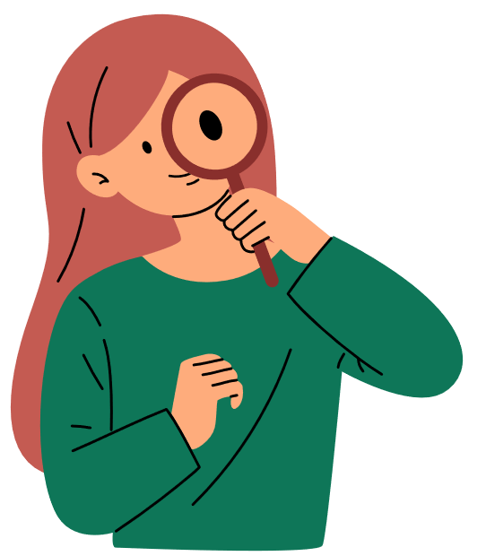
Let's try this!
A: let’s go horseback riding.
B:thanks, but maybe another time.
A: why don’t we go skiing?
B:that sounds great!

Slide 10
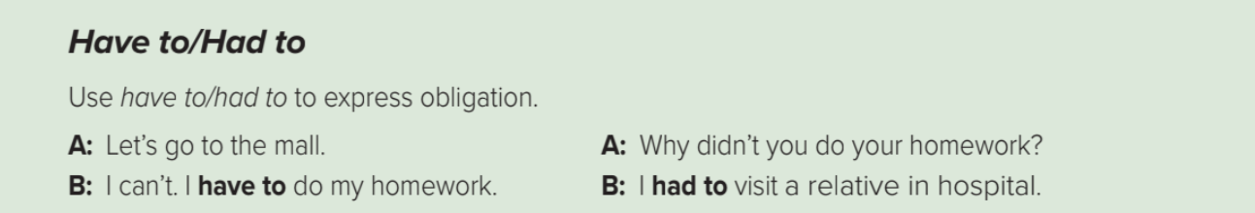

Obligation:
QUIZ:
Which sentence shows present obligation?
A:1- I have to clean my room.
2- I should clean my room.
3- I will have to clean my room tomorrow.
B:
(CORRECT)
1- She has to study for the test.
) CORRECT)
2- She had to study for the test last nighT.
3- She should study for the test.

Slide 11
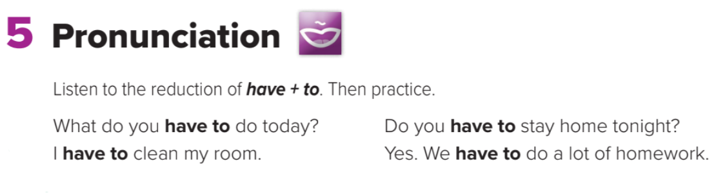

{Havta}
(or) {hafta}

Slide 12
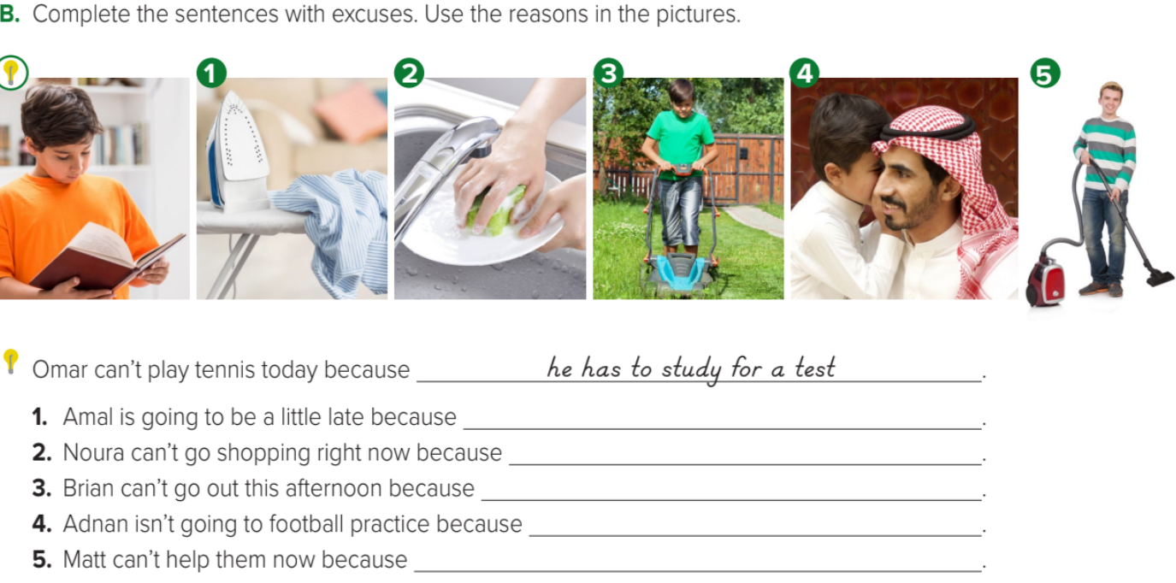

she has to do the laundry.
she has to wash the dishes.
he has to mow the lawn.
he has to babysit.
he has to clean the house.

Slide 13
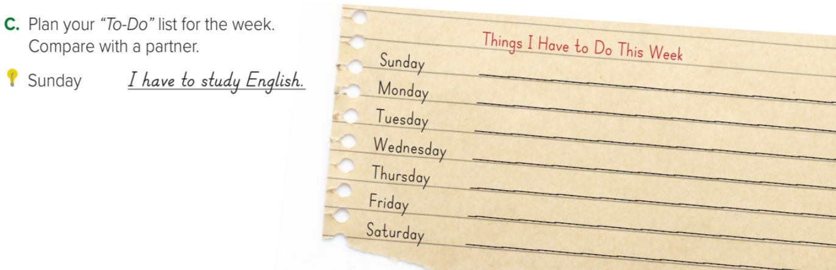

Answers

Slide 14
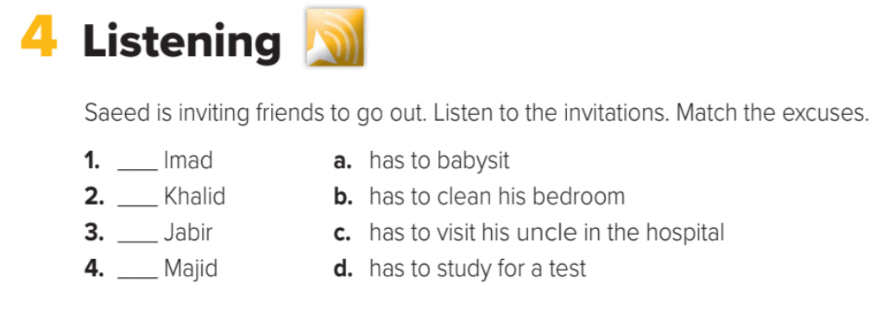
Listen and match:
d
a
c
b

Slide 15


You did it !
See you next time.
Thanks for watching

